Slide 1
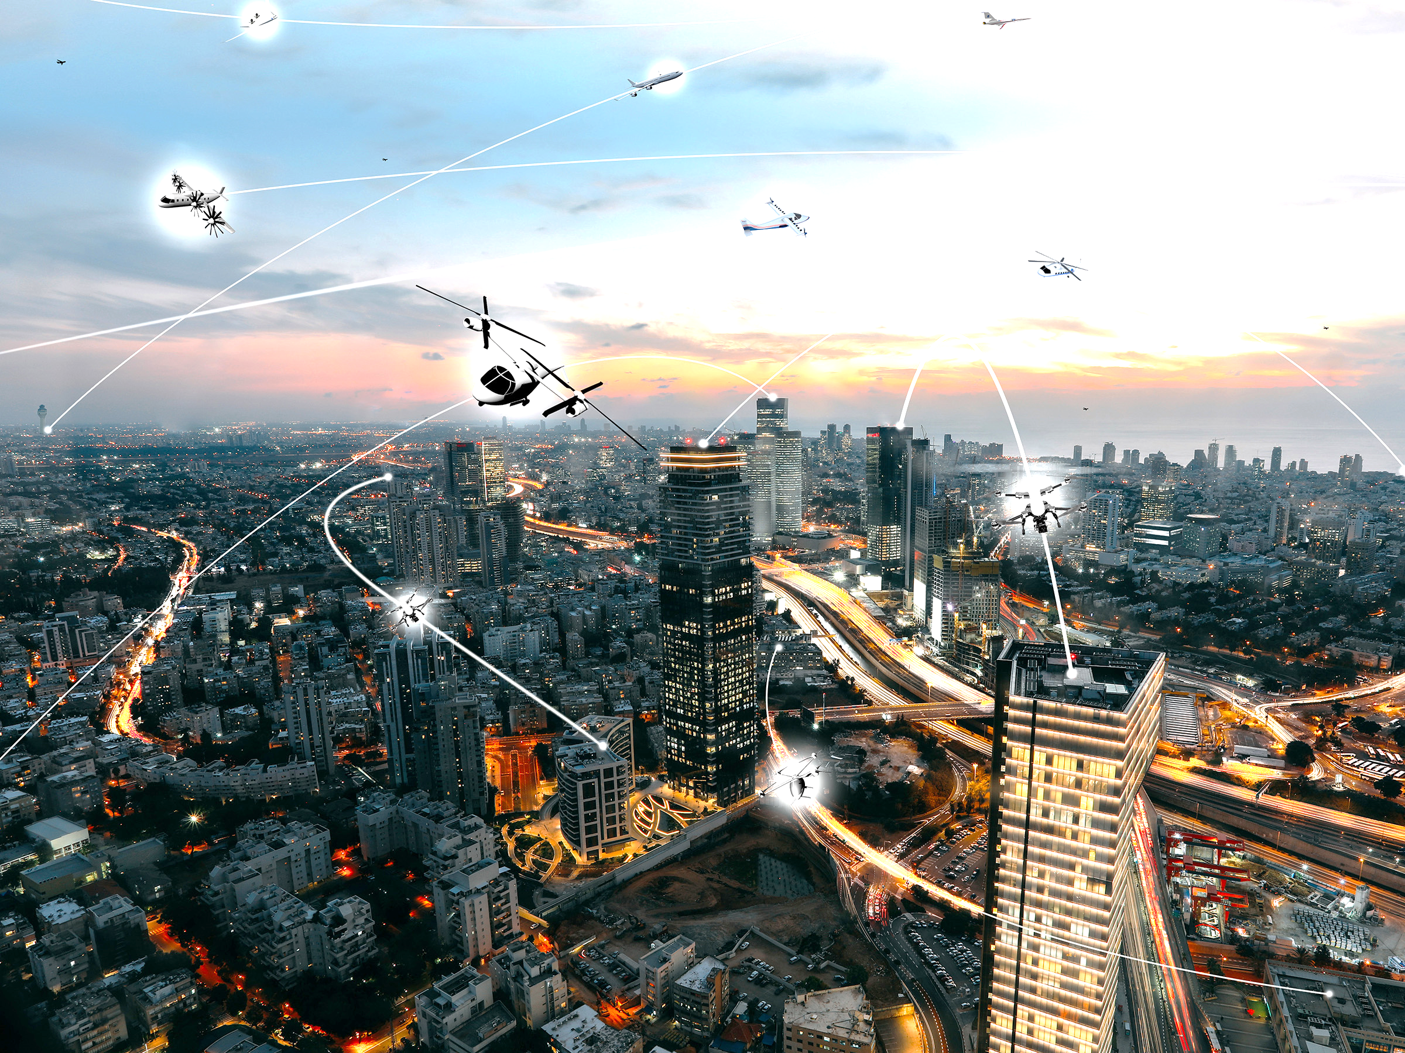









Optimal Integrated Routing and Charging strategies over a Spatial Network of UAVs
Salar Basiri, Dhananjay Tiwari, Srinivasa Salapaka
Department of Mechanical Science and Engineering
University of Illinois Urbana-Champaign
June 2023
Credits: NASA / Lillian Gipson

Slide 2
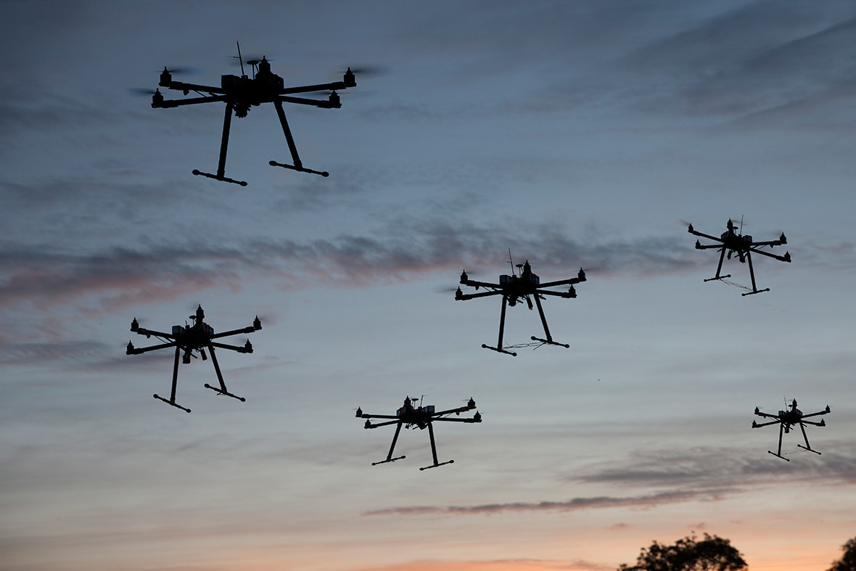

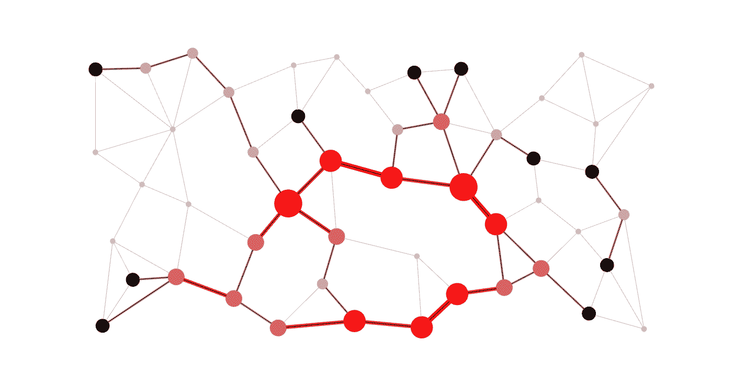

Planning problems in an autonomous UAV network
Facility Location & Routing
Scheduling & Routing
Scheduling with Pre-defined Routes
This Photo by Unknown Author is licensed under CC BY-NC
Intelligent Infrastructure and Logistics Support
Srinivasa Salapaka, UIUC

Slide 3







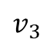
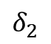
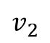
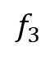
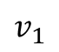
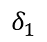
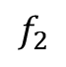
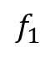
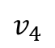
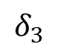
Problem Statement: FLPO
N drones, k charging UGVs, and T destination targets.
Each drone has a pre-defined charging capacity and an initial charge
The objective is to minimize the total weighted distance, over all drones to reach their destination, while ensuring that no drone runs out of charge on its way to the destination, and all obstacles are avoided.
The drones can choose to go to the destination directly or via a subset of charging facilities to ensure battery capacity, depending on the deploying coordinates and the destination.
Three questions are answered in this problem: What is the minimum number of charging stations we need to ensure feasibility of transportation? 2) what route should each UAV take from start to its destination? 3) where should the charging facilities be coordinated?
$$v_{1}$$
$$δ_{3}$$
$$f_{1}$$
$$f_{2}$$
$$δ_{1}$$
$$v_{4}$$
$$f_{3}$$
$$v_{2}$$
$$δ_{2}$$
$$v_{3}$$
Intelligent Infrastructure and Logistics Support
Srinivasa Salapaka, UIUC

Slide 4
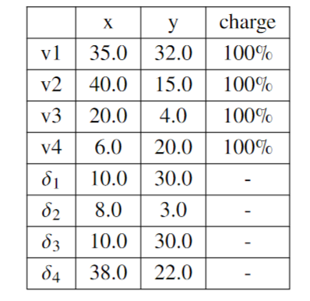
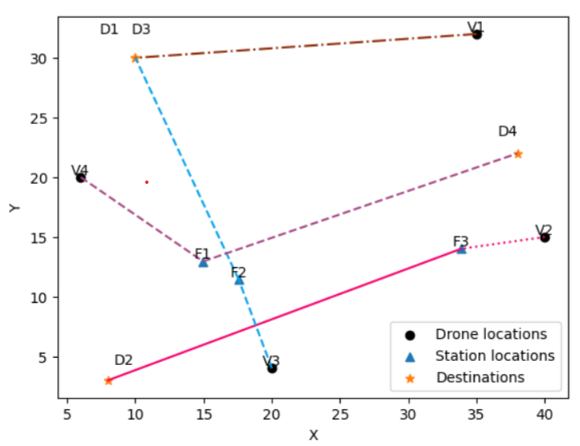
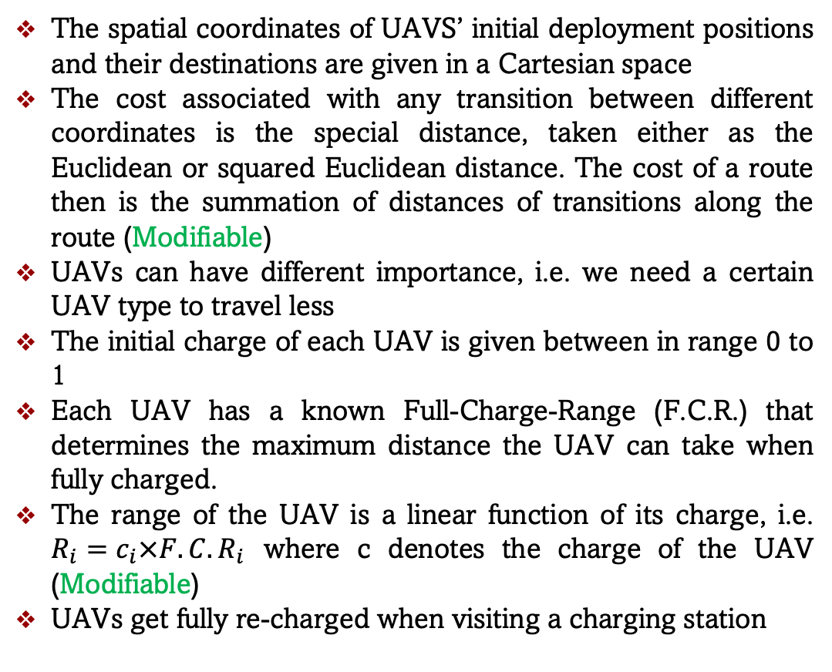
Assumptions
The spatial coordinates of UAVS’ initial deployment positions and their destinations are given in a Cartesian space
The cost associated with any transition between different coordinates is the special distance, taken either as the Euclidean or squared Euclidean distance. The cost of a route then is the summation of distances of transitions along the route (Modifiable)
UAVs can have different importance, i.e. we need a certain UAV type to travel less
The initial charge of each UAV is given between in range 0 to 1
Each UAV has a known Full-Charge-Range (F.C.R.) that determines the maximum distance the UAV can take when fully charged.
The range of the UAV is a linear function of its charge, i.e. $R_{i}=c_{i}×F.C.R_{i}$ where c denotes the charge of the UAV (Modifiable)
UAVs get fully re-charged when visiting a charging station
Intelligent Infrastructure and Logistics Support
Srinivasa Salapaka, UIUC

Slide 5
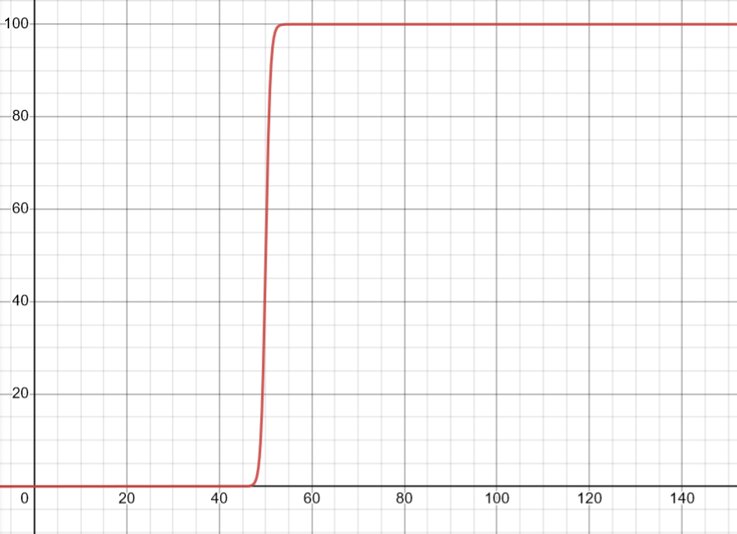
Scenario Feasibility Criteria
A large cost is associated with a transition that has a distance bigger than the range of the UAV at that stage
The cost is in the form of a tanh function from 0 to inf
Although within the range of a UAV, it might still not take the transition due to high risk of battery depletion (see figure)
Given the initial coordinates of the UAVs, their destinations, their initial charging, and the available number of charging stations, there could be no feasible solution (all UAVs reaching their destination without running out of charge along the route)
The infeasibility of the scenario can be easily determined by looking at the overall cost after the optimization termination
Hence we can determine the minimum number of charging stations for a given scenario
Intelligent Infrastructure and Logistics Support
Srinivasa Salapaka, UIUC

Slide 6



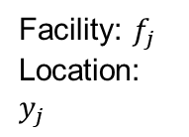
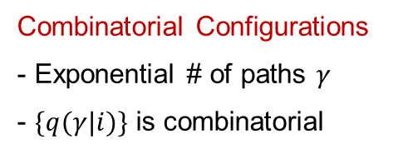
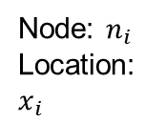
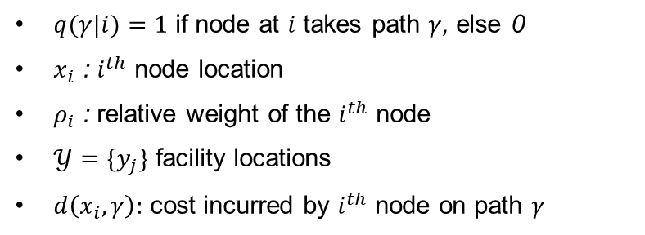
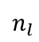
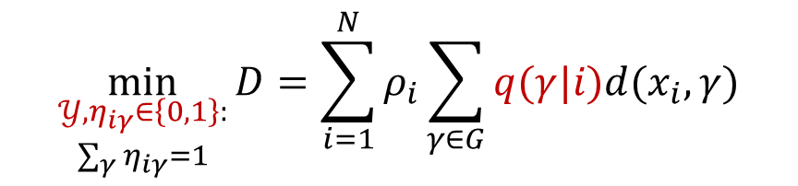
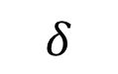
Baseline Para-SDM : Facility Location with Path Optimization
Application areas: Supply chain networks, Sensor networks, Last Mile delivery
$$\min_{\begin{aligned}𝒴,η_{iγ}∈\left\{0,1\right\}: \\ \sum_{γ}{η_{iγ}=1}\end{aligned}}{D=\sum_{i=1}^{N}{ρ_{i}\sum_{γ∈G}{q(γ|i)d(x_{i},γ)}}}$$
‘M’ facilities
$$δ$$
Facility: $f_{j}$
Location: $y_{j}$
$$Ω$$
$q(γ|i)=1$ if node at $i$ takes path $γ$, else 0
$x_{i}$ : $i^{th}$ node location
$ρ_{i}$ : relative weight of the $i^{th}$ node
$𝒴=\{y_{j}\}$ facility locations
$d\left(x_{i},γ\right):$ cost incurred by $i^{th}$ node on path $γ$
$$n_{l}$$
Node: $n_{i}$
Location: $x_{i}$
Path: Sequence of facilities from nodes to destination
$$n_{i}→f_{r_{1}}→f_{r_{2}}→…f_{r_{q}}→δ$$
Combinatorial Configurations
- Exponential # of paths $γ$
- $\{q(γ|i)\}$ is combinatorial
$$γ$$
Parameters: Facility locations $Y≔\{y_{j}\}$
Intelligent Infrastructure and Logistics Support
Srinivasa Salapaka, UIUC

Slide 7
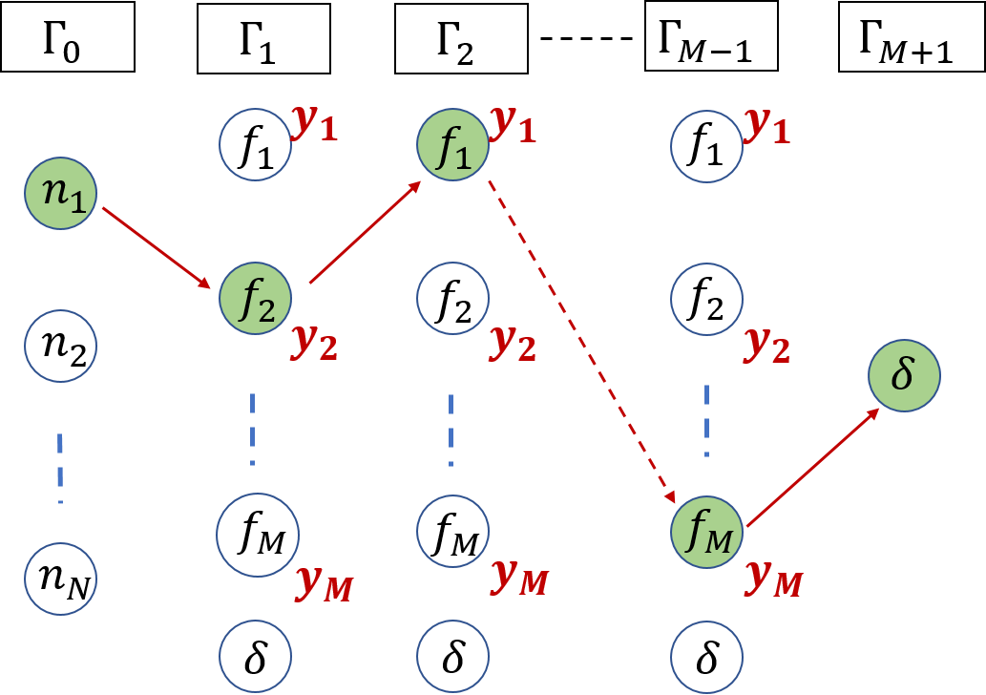
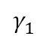
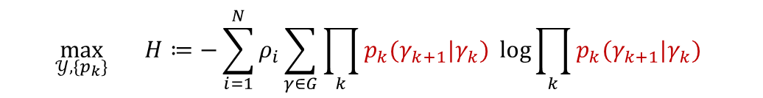
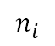

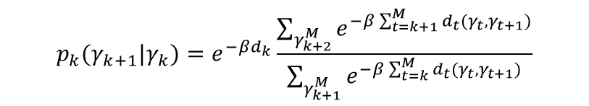
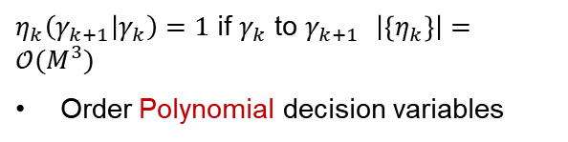
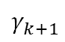

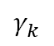
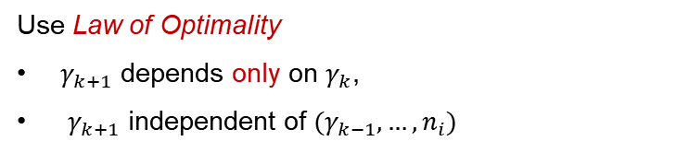
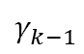

Stagewise Viewpoint for para-SDM
Stages Illustration
Path $γ≡γ_{1}→γ_{2}→…→γ_{M}$
$$γ_{k}$$
$$γ_{k−1}$$
$$M$$
$$γ_{k+1}$$
Use Law of Optimality
$γ_{k+1}$ depends only on $γ_{k}$,
$γ_{k+1}$ independent of ${(γ}_{k−1},…,n_{i})$
$$γ_{1}$$
$$n_{i}$$
$$η_{iγ}=\prod_{k=1}^{M−1}{η_{k}(γ_{k+1}|γ_{k}})$$
$η_{k}\left(γ_{k+1} | γ_{k}\right)=1$ if $γ_{k}$ to $γ_{k+1}$ $\left|\left\{η_{k}\right\}\right|=𝒪(M^{3})$
Order Polynomial decision variables
$$\max_{𝒴,\{p_{k}\}}{ H≔−\sum_{i=1}^{N}{ρ_{i}\sum_{γ∈G}{\prod_{k}{p_{k}(γ_{k+1}|γ_{k}) }\log{\prod_{k}{p_{k}(γ_{k+1}|γ_{k}) }}}}}$$
Solution is Gibbs’ distribution
$$p_{k}(γ_{k+1}|γ_{k})=e^{−βd_{k}}\frac{\sum_{γ_{k+2}^{M}}{e^{−β\sum_{t=k+1}^{M}{d_{t}(γ_{t},γ_{t+1})}}}}{\sum_{γ_{k+1}^{M}}{e^{−β\sum_{t=k}^{M}{d_{t}(γ_{t},γ_{t+1})}}}}$$
$$D:=\sum_{i=1}^{N}{ρ_{i}\sum_{γ∈G}{\prod_{k}{p_{k}(γ_{k+1}|γ_{k})}d(x_{i},γ)}}=d_{0},$$
subject to
Facility Locations $𝒴={\left(2A−B\right)}^{−1}(\overline{X}+C)$
Intelligent Infrastructure and Logistics Support
Srinivasa Salapaka, UIUC

Slide 8
Code (inputs-outputs)
# a list of drones, each element containing two tuples,
# representing the coordinates of the initial deployment position
# the destination coordinates, and initial charge respectively
drones=[((35.0,32.0),(10.0,30.0),1.0),
((40.0,15.0),(8.0,3.0),1.0),
((20.0,4.0),(22.0,20.0),1.0),
((6.0,20.0),(38.0,22.0),0.70)]
# a list of initial deployment location of charging UGVs, could be random.
# the size of the list determines the number of charging stations
stations=array([[20.0,20.0],
[20.0,20.0],
])
# a list of possible blocks (obstacles) in the environment, and their
# radius of effect
blocks=[((17.0,30.0),3.0),
((25.0,13.0),1.5)] # if no blocks are there, then put blocks=None
fcr = 25.0 # Full Charge Range
ugv_factor = 0.0 # the cost factor for UGV transportation
distance = 'euclidean' # distance measure in the environment
beta_init = 1e-8 # initial beta value for the optimization.
beta_f = 100 # final beta value for the optimization
alpha = 1.5 # beta growth rate
purturb = 0.1 # random purturbation in optimization
env=uav_flpo(drones,stations,blocks=blocks,
ugv_factor=ugv_factor,fcr=fcr,distance=distance)
env.train(beta_init=beta_init,beta_f=beta_f,alpha=alpha,
purturb=purturb,method='nelder-mead',verbos=1)
Intelligent Infrastructure and Logistics Support
Srinivasa Salapaka, UIUC

Slide 9
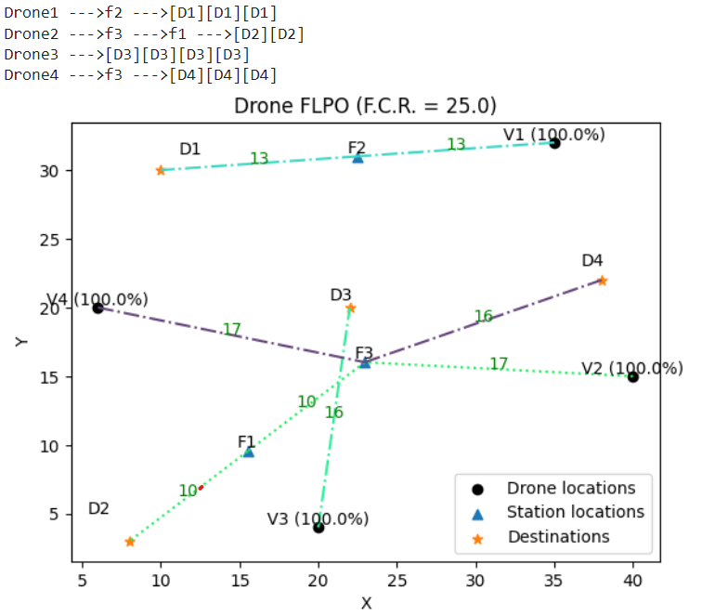
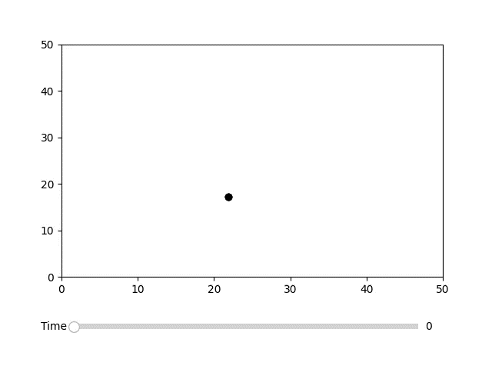
Simulations: Scenario 1
Phase transition
Intelligent Infrastructure and Logistics Support
Srinivasa Salapaka, UIUC

Slide 10
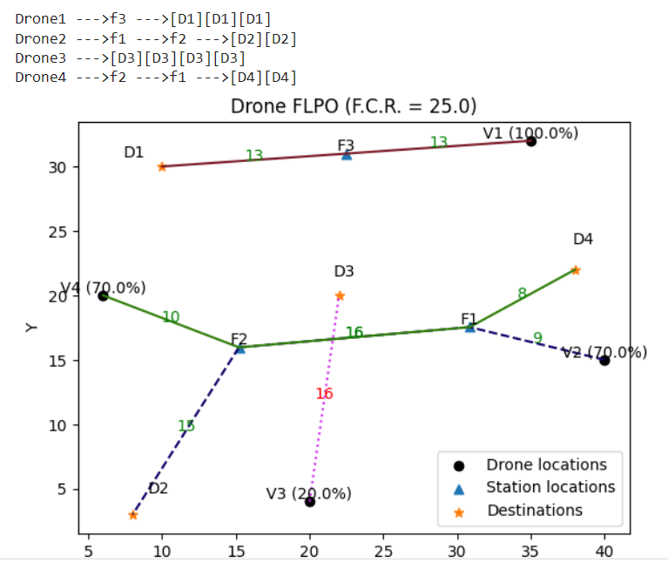
Simulations: Scenario 4
Infeasible Scenario!
The number of facilities should increase
Intelligent Infrastructure and Logistics Support
Srinivasa Salapaka, UIUC

Slide 11
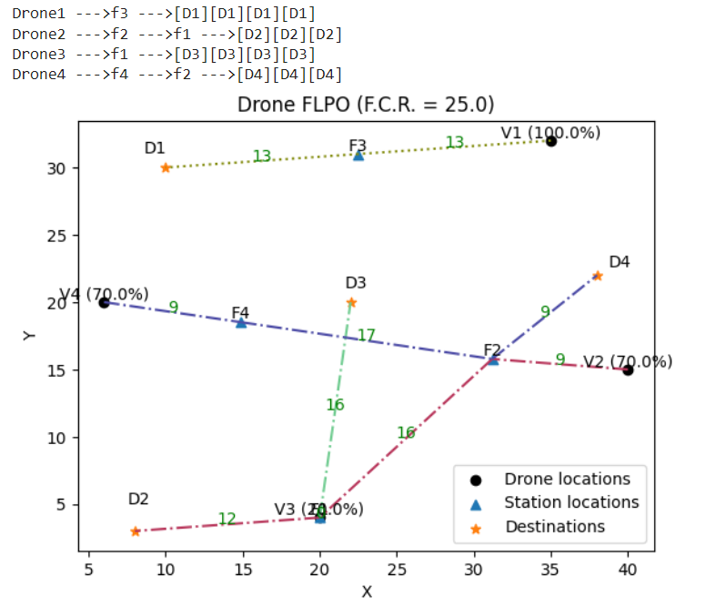
Simulations: Scenario 5
Feasible with 4 stations
Intelligent Infrastructure and Logistics Support
Srinivasa Salapaka, UIUC

Slide 12
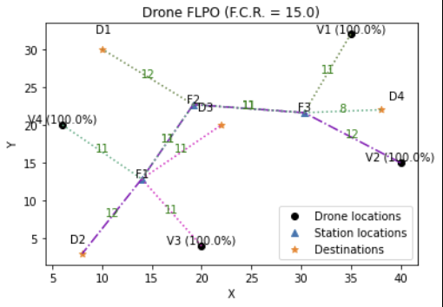
Simulations: Scenario 6 (changing F.C.R.)
Drone1 --->f3 --->f2 --->[D1][D1]
Drone2 --->f3 --->f2 --->f1 --->[D2]
Drone3 --->f1 --->[D3][D3][D3]
Drone4 --->f1 --->f2 --->f3 --->[D4]
Intelligent Infrastructure and Logistics Support
Srinivasa Salapaka, UIUC

Slide 13



Obstacle Avoidance
Corrected route
ROE
The UAV takes a corrected route to avoid obstacles, and the additional cost is accounted for in the cost function
Radius of Effect
Intelligent Infrastructure and Logistics Support
Srinivasa Salapaka, UIUC

Slide 14
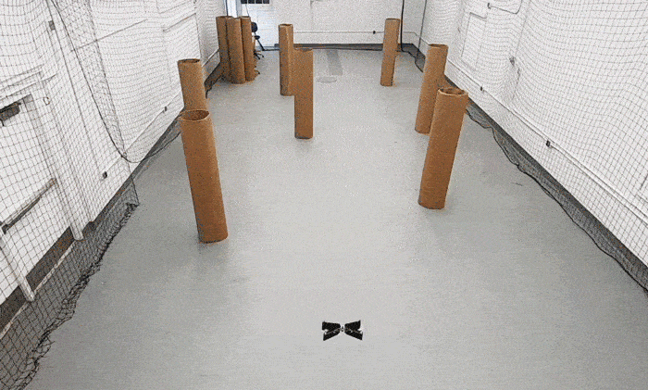
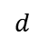
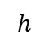
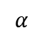
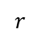
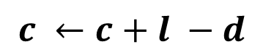
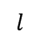
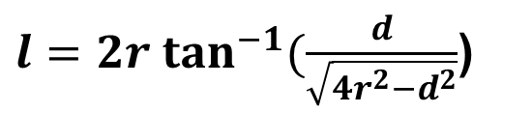
Obstacle Avoidance
$$h$$
$$α$$
$$l$$
$$r$$
$$d$$
$l=2r \tan^{−1}(\frac{d}{\sqrt{4r^{2}−d^{2}}}$)
$$c ←c+l −d$$
The corrected cost
Intelligent Infrastructure and Logistics Support
Srinivasa Salapaka, UIUC

Slide 15
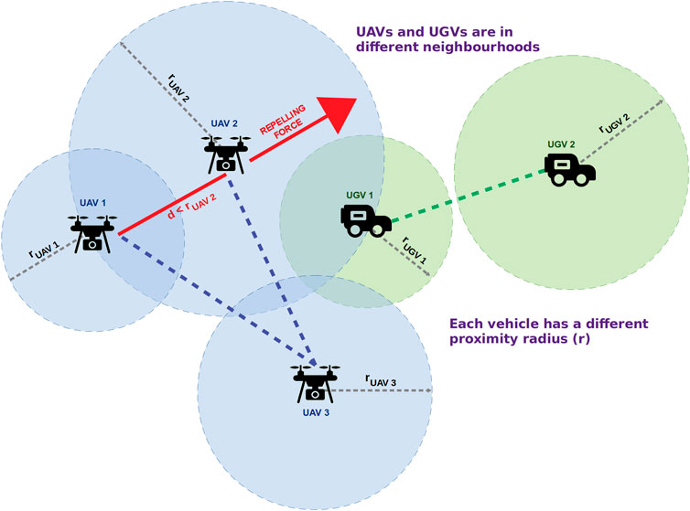
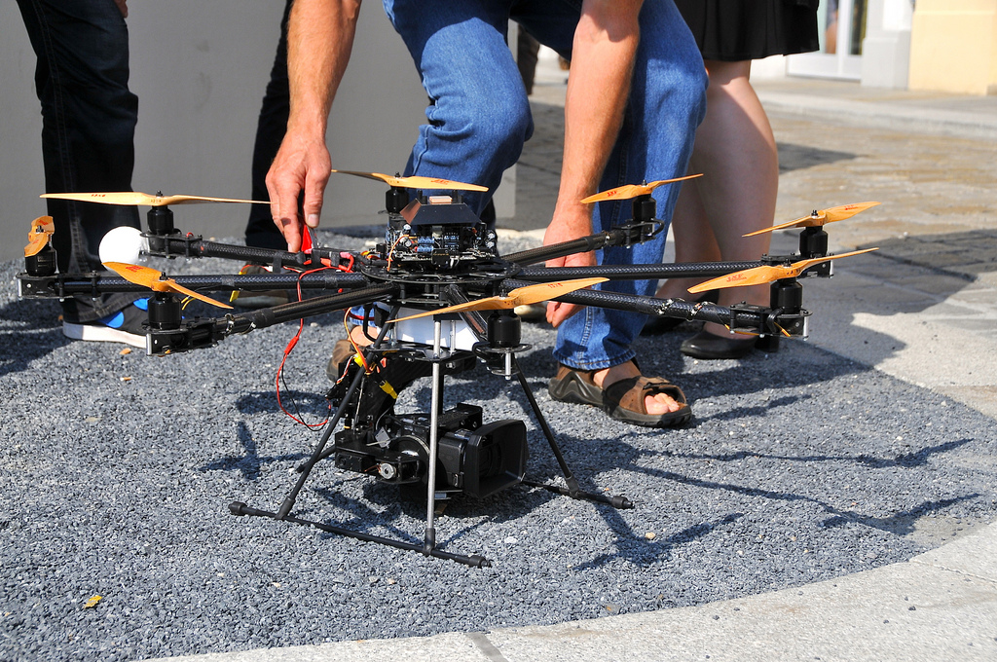
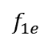







UGV transportation Cost
$$f_{2e}$$
$$f_{2_{s}}$$
$$f_{1_{s}}$$
$$f_{3e}$$
$$f_{1e}$$
$$f_{3_{s}}$$
This Photo by Unknown Author is licensed under CC BY
$$C_{\left\{ugv\right\}}=α\sum_{i}{{\left(f_{i_{e}} −f_{i_{s}}\right)}^{2}}$$
This Photo by Unknown Author is licensed under CC BY-SA-NC
$α$ : UGV cost factor
Intelligent Infrastructure and Logistics Support
Srinivasa Salapaka, UIUC

Slide 16


Simulations: Scenario 7 (Adding blocks)
Initial UGV location
Initial UGV location
UGV cost factor= 0
UGV cost factor= 100
Intelligent Infrastructure and Logistics Support
Srinivasa Salapaka, UIUC

Slide 17

Problem Statement: Routing + Scheduling
N drones, k stationary charging stations, and T destination targets.
Each drone has a pre-defined charging capacity, an initial deployment time and an initial charge
The objective is to minimize the total weighted travel time, over all drones to reach their destination, while ensuring that no drone runs out of charge on its way to the destination, or no traffic congestion happens at the charging facilities, while all obstacles are avoided.
The drones have speed limits, and can be deployed at different times during the operation
Three questions are answered in this problem: 1) what route should each drone take to its destination? 2) at what times should each drone reach their assigned coordinates along their routes?
$$f_{1}$$
$$v_{1}$$
$$δ_{3}$$
$$f_{2}$$
$$δ_{1}$$
$$v_{4}$$
$$f_{3}$$
$$v_{2}$$
$$δ_{2}$$
$$v_{3}$$
This Photo by Unknown Author is licensed under CC BY-SA
Intelligent Infrastructure and Logistics Support
Srinivasa Salapaka, UIUC

Slide 18

Problem Statement: Routing + Scheduling
$$f_{1}$$
$$v_{1}$$
$$δ_{3}$$
$$f_{2}$$
$$δ_{1}$$
$$v_{4}$$
$$f_{3}$$
$$v_{2}$$
$$δ_{2}$$
$$v_{3}$$
Intelligent Infrastructure and Logistics Support
Srinivasa Salapaka, UIUC

Slide 19










Problem Statement: Routing + Scheduling in FLPO Framework
Stage Illustration for drone n
$$f_{1}$$
$$v_{1}$$
$$δ_{3}$$
$$f_{2}$$
$$δ_{1}$$
$$v_{4}$$
$$f_{3}$$
$$v_{2}$$
$$δ_{2}$$
$$v_{3}$$
Intelligent Infrastructure and Logistics Support
Srinivasa Salapaka, UIUC

Slide 20
Code (inputs-outputs)
# a list of drones, each element containing two tuples,representing the coordinates of the initial deployment position the destination coordinates,initial charge, the time of deployment, and max speed
max_speed=7.0
drones=[((35.0,32.0),(10.0,30.0),1.0,0.0,max_speed),
((40.0,15.0),(8.0,3.0),0.5,0.0,max_speed),
((20.0,4.0),(22.0,20.0),0.8,0.0,max_speed),
((6.0,20.0),(38.0,22.0),0.7,0.0,max_speed)]
stations=array([[18.7, 27.3],
[16.6, 16.9],
[34.4, 16.4]])
# a list of possible blocks (obstacles) in the environment, and their
# radius of effect
blocks=[((17.0,30.0),3.0),
((25.0,13.0),1.5)] # if no blocks are there, then put blocks=None
distance = 'euclidean' # distance measure in the environment
fcr=25.0
beta_init = 1e-15 # initial beta value for the optimization.
beta_f = 10 # final beta value for the optimization
alpha = 1.1 # beta growth rate
purturb = 0.01 # random purturbation in optimization env=uav_flpo(drones,stations,blocks=blocks,
fcr=fcr,distance=distance)
env.train(beta_init=beta_init,beta_f=beta_f,alpha=alpha,
purturb=purturb,method=None,verbos=1)
Intelligent Infrastructure and Logistics Support
Srinivasa Salapaka, UIUC

Slide 21


PTF : processing time frame (charging time at each station)
PLAY THE VIDEO!
PTF = 2.0
Obstacle consideration

Slide 22


Simulations: scheduling + routing + Congestion avoidance
PTF = 0
PTF = 4.0
Congestion happening at f1
Intelligent Infrastructure and Logistics Support
Srinivasa Salapaka, UIUC

Slide 23

Problem Statement: Scheduling on pre-defined routes
N drones, k stationary charging stations, and T destination targets.
Each drone has a pre-defined charging capacity, an initial deployment time, and given routs on a set of aerial nodes
The objective is to schedule drones to minimize the total weighted travel time, to reach their destination, while ensuring no traffic congestion happens at the charging facilities
Three constraints: processing time constraint, precedence order constraint, and congestion constraint
The drones have speed limits, and can be deployed at different times during the operation
This Photo by Unknown Author is licensed under CC BY
Intelligent Infrastructure and Logistics Support
Srinivasa Salapaka, UIUC

Slide 24

Problem Statement: Scheduling on pre-defined routes
Drone_list=[
[(0, 3), (1, 2), (2, 2)],
[(0, 2), (2, 1), (1, 4)],
[(1, 4), (2, 3)]
]
The Drone_list is a list of drones where each list contains the route of drones. Each tuple represents the node id and corresponding processing time respectively
Intelligent Infrastructure and Logistics Support
Srinivasa Salapaka, UIUC

Slide 25



Final Remarks
Using actual data to run simulations
Codes will be available on Github repos
Any suggestions for improvement?
Sensitivity analysis
Cost functions for waiting (or landing)
This Photo by Unknown Author is licensed under CC BY-SA-NC
Intelligent Infrastructure and Logistics Support
Srinivasa Salapaka, UIUC

Slide 26

Thank You!
Salar Basiri
Department of Mechanical Science and Engineering
University of Illinois Urbana-Champaign
salapaka@illinois.edu
Intelligent Infrastructure and Logistics Support
Srinivasa Salapaka, UIUC

